Slide 1
6MMCS002W Digital Marketing, Social Media & Web Analytics
Week 5 –Social Media & seo
Dr Vassiliki Bouki
boukiv@wmin.ac.uk

Slide 2
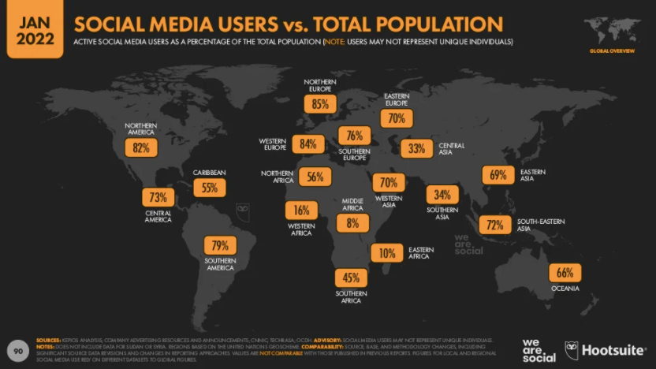
Social Media today
Source: https://www.smartinsights.com/social-media-marketing/social-media-strategy/

Slide 3
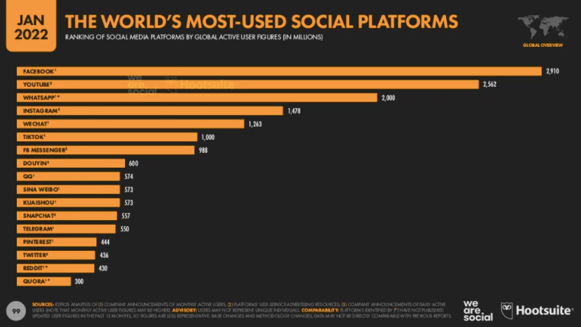
Social Media today
Source: https://www.smartinsights.com/social-media-marketing/social-media-strategy/

Slide 4
Social Media
What is the relationship between SEO and social media?
... at the end of the day, ‘link building’ was always about ‘social proofing’
How can social media help to make your site more ‘visible’?
Social media and SEO
SMO or SEO?
Social Search
Social media instead of search engines? (Facebook social search)
Myths (?) about social media – what sociologists say – other reports

Slide 5
Social media and SEO
Do social media really affect page ranking? How do we know that page ranking is associated with social media?
In the Search Market Expo (SMX) event 2010 in Munich Bing’s and Google’s representatives indicated that they use ‘social signals’ because it is comparatively easy to find social media spam than it is with link spam ➔ Social signals become the new links
Several studies to prove it: https://blog.hootsuite.com/social-media-seo-experiment/
Still there are questions if and how…

Slide 6
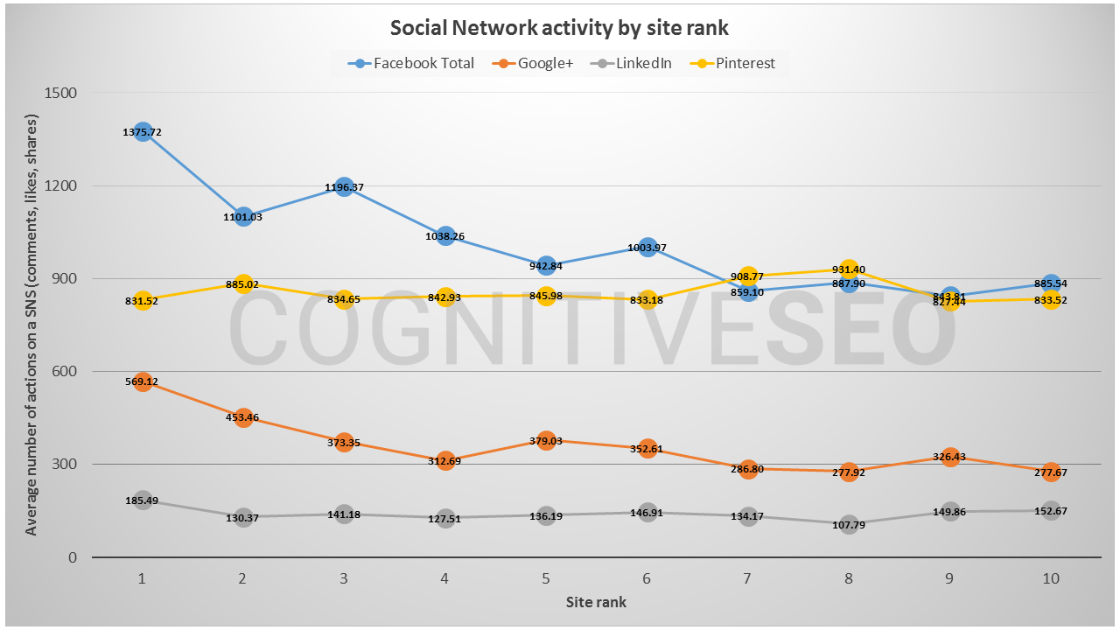
Social media and SEO
Which social networks affect ranking more?
https://cognitiveseo.com/blog/11903/social-signals-seo-influence/

Slide 7
Social media and SEO
What are “social signals”?
Social signals that might directly influence the ranking of your site: (not all search engines use the same social signals or use them in the same way):
Facebook Shares and Likes
Links in tweets
Links shared in Google+ and Google +1s

Slide 8


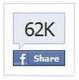
Social media and SEO
Links in tweets
Links in tweets are considered ‘link-like’ signal
Authority of authors on Twitter (several criteria; having many followers but not follow that many is a strong indication of authority).
Facebook Shares and Likes
Share or Like?
They also are considered ‘votes’
Facebook authority

Slide 9


Social media and SEO
Links shared in Google+
Started in 2011 – works in a similar way as Facebook: if a link is inserted into a post in the site Google+ recognises the URL and extracts content
Vote & authority
Google +1
+1 button allows visitors to recommend your content on Google Search and share it on Google+
Works similar to Facebook likes

Slide 10
Social media and SEO
Are Social Signals a Ranking Factor?
“First of all, Google says that social signals are not a direct ranking factor.
This doesn’t mean social signals won’t help with Google SEO in an indirect way, which we will discuss later, but it means it won’t directly boost your rankings in Google.
Matt Cutts of Google posted a video several years ago that said that Google does use data from social sites in ranking, however, this is outdated now, and may not be accurate anymore.”
(https://www.seohermit.com/articles/how-social-signals-help-seo/ 8th February 2022)
Which activities on Facebook (might) influence search?

Slide 11
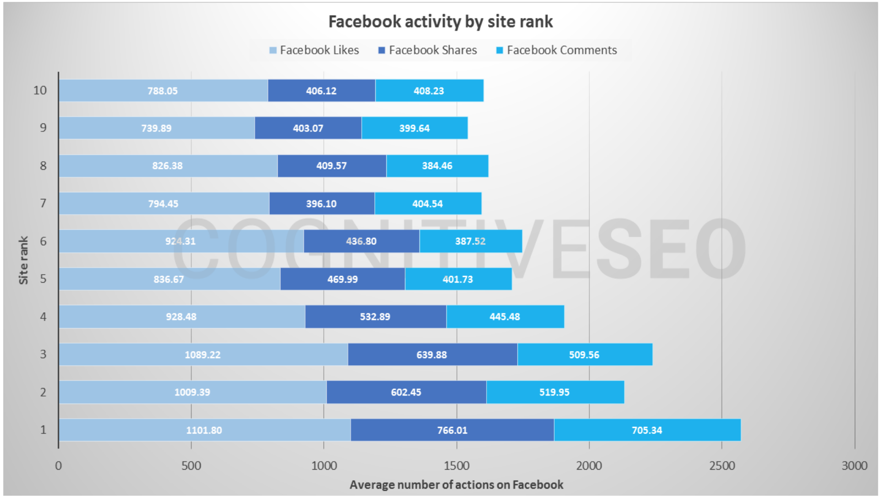
Social media and SEO
Differences in Facebook signals
A study by ‘Cognitive SEO’: https://cognitiveseo.com/blog/11903/social-signals-seo-influence/

Slide 12
Social media and SEO
Social signals that indirectly influence the ranking of your site:
Build and engage audience (content; announcements; product previews etc)
Customer Service
Spread the word
Generate searches

Slide 13
SMO or SEO?
What is Social Media Optimization?
7 tips to improve SMO
Reputation - build your reputation as a reliable qualified source
Engagement - encourage more engagement, sharing & reciprocate
Authority - become a notable authority in your field of expertise
Leadership - harness originality & creativity, be a Thought Leader
Social - be social, find and engage sociable experts in your field
Media - know your social media platforms to maximize influence
Optimization - improve technical aspects to increase optimization

Slide 14
SMO or SEO?
Social Media do more than influence page ranking:
Spread your message and listen to your customers
Use social media for market research
SMO & SEO
Social conversations inform keyword strategy & search keywords inform social content strategy
SEO is no longer just about content, linking, and site architecture; it’s also about building social identity, relationships and engagement.
By using social data to determine what customers want and where they prefer to consume online content combined with SEO data, you can develop a strategy that can target your customer in a way that is seamless and well informed.

Slide 15
SMO or SEO?
Is SEO ‘dead’?
http://www.theguardian.com/technology/2013/jul/22/seo-is-dead-long-live-social-media-optimisation
Is SMO the new SEO?
Your views

Slide 16
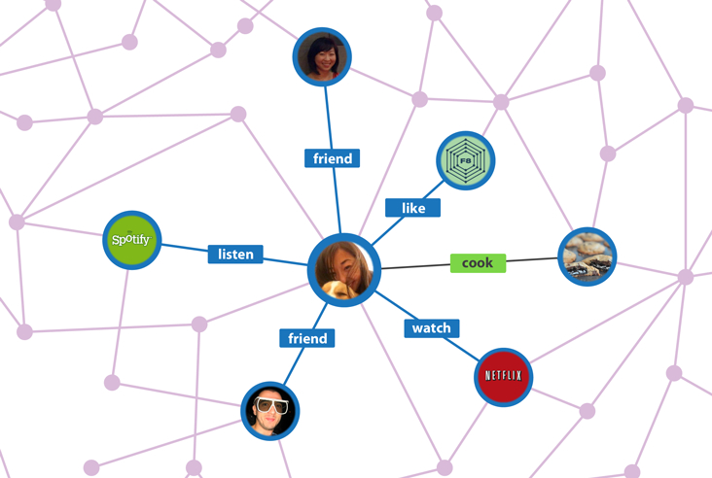
Social Search
Web goes social...
Social search
Social search or a social search engine is a type of web search that takes into account the Social Graph of the person initiating the search query.
When applied to web search this Social-Graph approach to relevance is in contrast
to established algorithmic or machine-based approaches where relevance is determined
by analyzing the text of each document or the link structure of the documents.
Search results produced by social search engine give more visibility to content created
or "touched" by users in the Social Graph.
(from Wikipedia: http://en.wikipedia.org/wiki/Social_search)

Slide 17
Social Search
Web goes social Or ‘ask your friends’
How Google and Bing incorporate ‘social search’ in their results?
Google → Google + profile
http://www.youtube.com/watch?v=ZqWJxgp-_mU
Bing → Facebook
http://www.youtube.com/watch?v=jfO7HnGT0T4

Slide 18
Social Search
Consumer search click-through rates increase 94% when they are exposed to relevant branded social media, according to data cited by Prestige Marketing.
Moreover, 78% of consumers trust personal recommendations over search result rankings.
And 48% of online purchasers use both search and social media to make decisions.

Slide 19
Social search instead of search engines?
In March 2013 (!) Facebook introduced the ‘Facebook Graph Search’
‘Facebook Graph Search’ is a semantic search engine that is designed to give answers to user natural language queries rather than a link of graphs.
The Graph Search combines the big data acquired from its users and external data.
http://en.wikipedia.org/wiki/Facebook_Graph_Search

Slide 20
Social search instead of search engines?
Facebook supports searches for the following types:
People
Pages
Places (limitable to a specific location (latitude and longitude) and distance)
Check-ins of the user, friends, or where user or friends have been tagged
Objects with location information attached. In addition, the returned objects will be those in which the user or friends have been tagged, or those objects that were created by the user or friends.
Posts and comments
Could search engines being replaced? Your views?
http://searchengineland.com/facebook-search-not-google-search-145124

Slide 21
Myths (?) about social media
Making the website visible is only the first step.
How many of real purchases / online transactions can be traced back to social media? In other words what is the ROI of social media?
Some more statistics (from Monetate Company & Forrester Research)
Online searches (organic results) were the greatest contributor to e-commerce visits and sales, representing 31.43 percent of sales traffic.
Even email, at 2.82 percent, outperformed social media, which the study said accounts for a meagre 1.55 percent of all e-commerce traffic.
In a report of 2012 by Forrester Research, less than 1 percent of online transactions among US customers could be traced to a social media post. For new customers, organic search represented 16% of business, and for repeat customers, email accounted for 13 percent.
http://www.adotas.com/social-media-vs-seo-the-hype-and-the-reality/

Slide 22
Myths (?) about social media
WHY?
Let’s see an example
Standard response rate is about 3%.
One international affordable retail chain has about 1,250,000 “likes” on its Facebook page.
This means that only 37,500 people (3%) are likely to take some action (in a new product / service etc)
From there, of course, the number goes up again, because each one of those 37,500 has a number of friends — let’s say 1,000.
Now we’re at an impressive 37.5 million. Three percent of that number is 1.125 million.
http://www.adotas.com/social-media-vs-seo-the-hype-and-the-reality/

Slide 23
Myths (?) about social media
How many of those respondent’s friends may be “real” friends???
How many do we trust and their opinion might have an effect?
Dunbar’s Number (https://en.wikipedia.org/wiki/Dunbar%27s_number)
Dunbar is a British anthropologist and evolutionary psychologist
Dunbar’s Number is a theoretical limit on the number of meaningful social interactions that anyone can have. That number ranges from 100 to 230, but on average it comes to 150.
According to Dunbar, “The figure of 150 seems to represent the maximum number of individuals with whom we can have a genuinely social relationship, the kind of relationship that goes with knowing who they are and how they relate to us.”
http://www.adotas.com/social-media-vs-seo-the-hype-and-the-reality/

Slide 24
Myths (?) about social media
Standard Response
Rate: 3%
Standard Response
Rate: 3%
1,250,000
likes
37,500
will take action & contact friends
37,5 millions
will receive the message
1,125,000
will take action
1,000 friends each
Standard Response
Rate: 3%
Standard Response
Rate: 3%
1,250,000
likes
37,500
will take action & contact friends
5,625,000
will receive the message
168,750
will take action
150 ‘meaningful’ friends each
Approx. 7.4% of the initial ‘likes’ might take action (if the response rate is 3%)

Slide 25
Myths (?) about social media
Going back to our example
An online search for the international affordable retailer from our earlier example comes up with 25.4 million hits (in total).
That search result is much less than the projected 37.5 million.
With less than 1% of online transactions to be traced to social media, the second number (168,750) sounds more realistic.

Slide 26
Myths (?) about social media
More bad news for Facebook?
Prediction of 2014 by Princeton University:
“Facebook will lose 80% of users by 2017, say Princeton researchers”
http://www.theguardian.com/technology/2014/jan/22/facebook-princeton-researchers-infectious-disease
But they were WRONG…

Slide 27
Next week
So far we have discussed web marketing; how search engines work; SEO techniques; SEO and Social Media.
There are NO lecture or tutorials during next week (week 6).
From week 7 we’ll discuss how we can monitor the results of SEO. We start the second main topic of this module: ‘Web Analytics’.
‘If you cannot measure it does not worth to do it’

